Slide 1
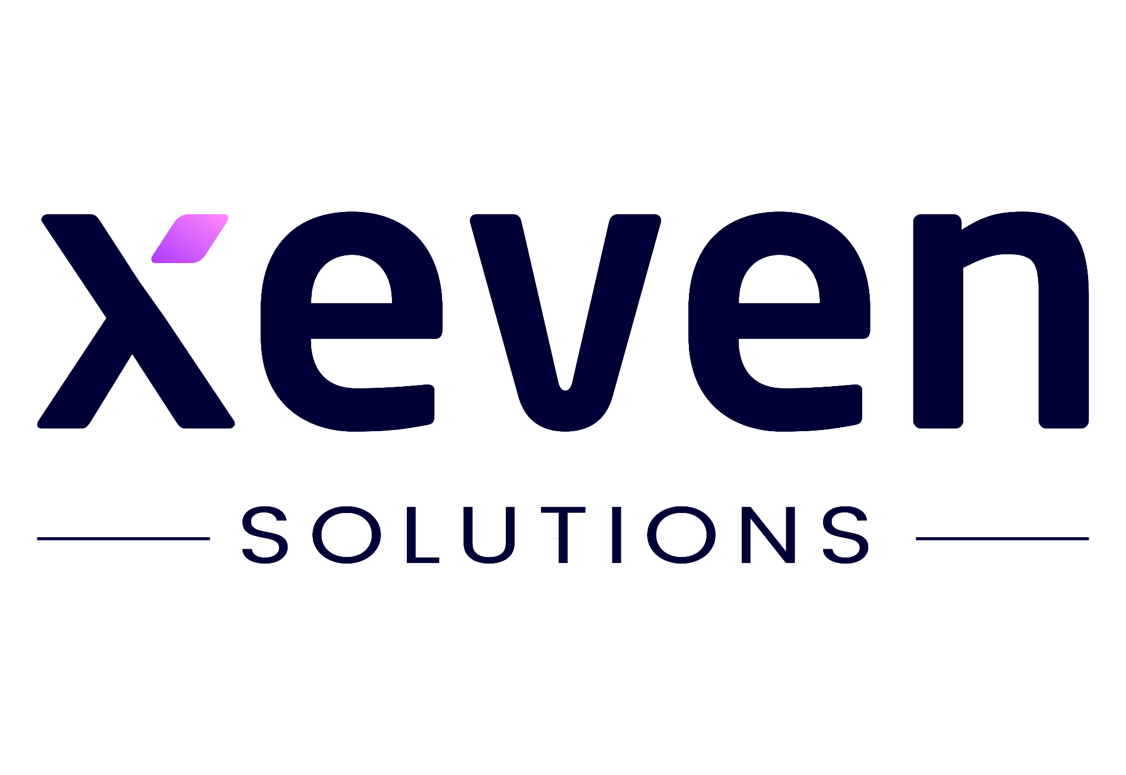

Lecture 01
Irfan Malik
Dr. Sheraz Naseer

Slide 2


Slide 3
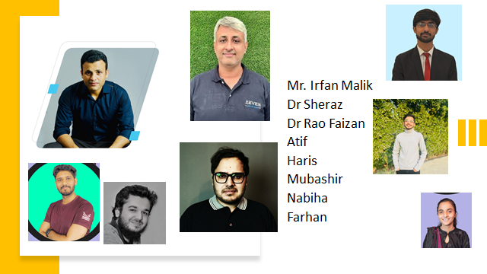
Who we are?

Slide 4
Agenda
What is AI ?
AI Value Creation
Machine Learning vs Deep Learning
Generative AI

Slide 5

Artificial Intelligence
Artificial Intelligence is study to create Digital brain

Slide 6
Value Creation By AI
McKinsey Global Institute estimates that AI could contribute up to $13 trillion to the global economy by 2030.
A study by PwC found that 72% of executives believe that AI will have a significant impact on their businesses in the next five years.
A report by Accenture found that companies that are early adopters of AI are twice as likely to outperform their competitors financially.

Slide 7
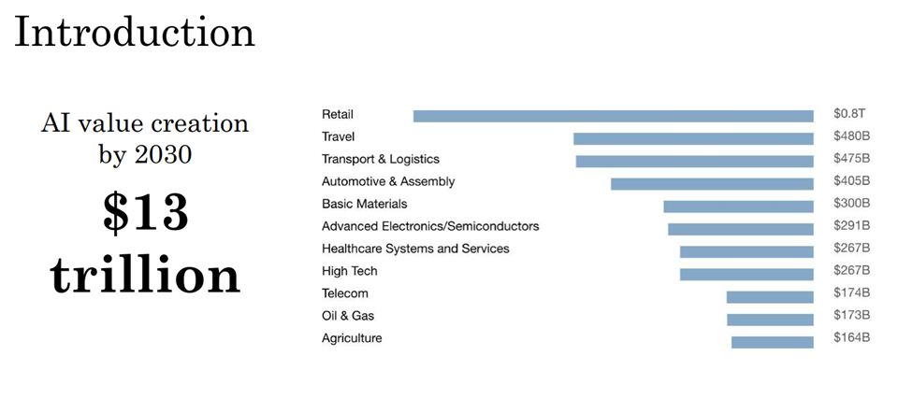

Slide 8
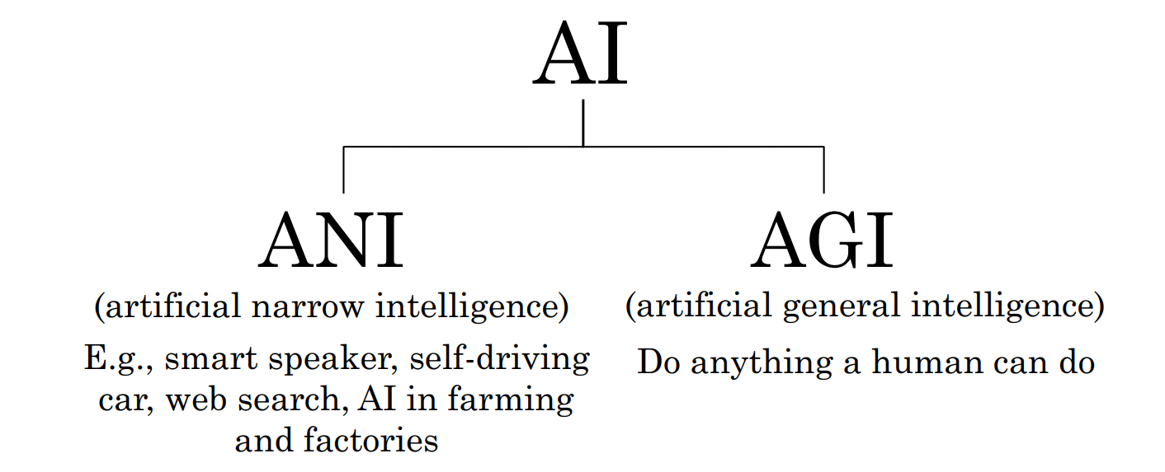
Demystifying AI
Source: Deeplearning.ai

Slide 9
Relationship in AI, ML and DL
Machine Learning:
SVM, Tree Algorithms, Nearest neighbors, bagging, boosting, Deep Learning
Artificial Intelligence:
Search Algorithms, Rule Based Systems, Statistical Inference, Machine Learning
Deep Learning:
FCNs, CNNs, RNNs, Transformers, Autoencoders, GANs

Slide 10
Artificial Intelligence
Machine Learning
Deep Learning
Artificial Intelligence is the branch of computer science concerned with development of methods that allow computers to learn without explicit programming.
Machine Learning is a branch of AI, which focuses on methods, that can learn from examples and experience instead of relying on hard-coded rules and make predictions on new data.
Subfield of Machine Learning that focuses on Neural Networks (Inspired from Biological neurons) to develop learning models.

Slide 11
ANI (Artificial Narrow Intelligence)
ANI refers to AI systems that are designed and trained for specific tasks or domains. These systems excel at performing a single task or a narrow range of tasks, but they lack the ability to generalize their knowledge to other domains.
Examples:
ANI include virtual assistants like Siri or Alexa, recommendation systems, and image recognition algorithms.

Slide 12
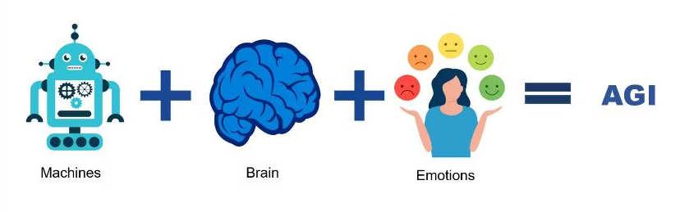
AGI (Artificial General Intelligence):
AGI, on the other hand, refers to AI systems that possess the ability to understand, learn, and apply knowledge across a wide range of tasks and domains, similar to human intelligence.

Slide 13
Most Popular Way to Do AI: Machine Learning
Machine Learning is a branch of AI, which focuses on methods, that can learn from examples and experience instead of relying on hard-coded rules and make predictions on new data.

Slide 14
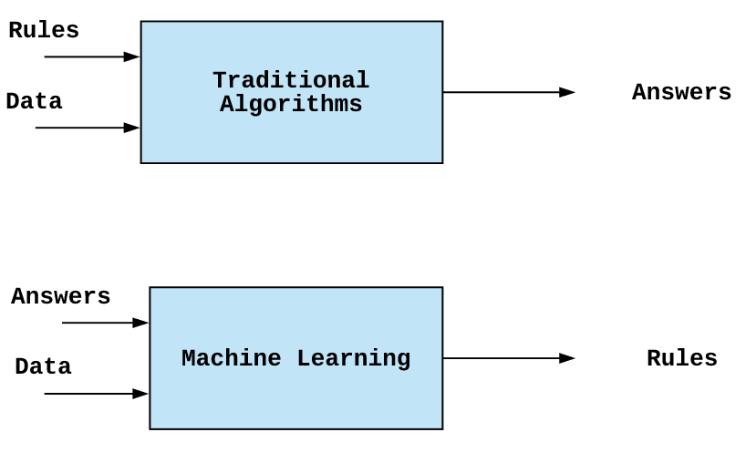
Difference in ML and Classical AI

Slide 15
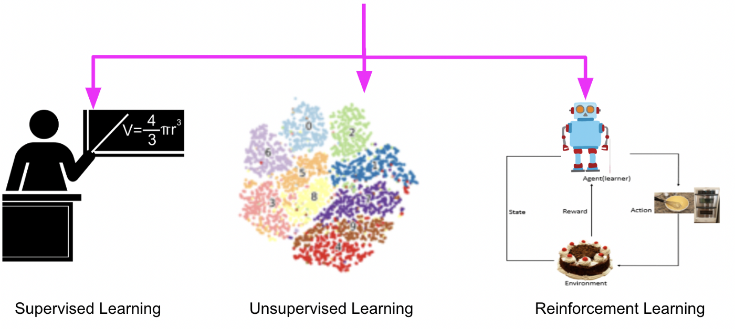
Types of Machine Learning
Supervised Learning (learning with labeled data)
Unsupervised Learning (discover patterns in unlabeled data)
Reinforcement learning (learn to act based on feedback/rewards)

Slide 16
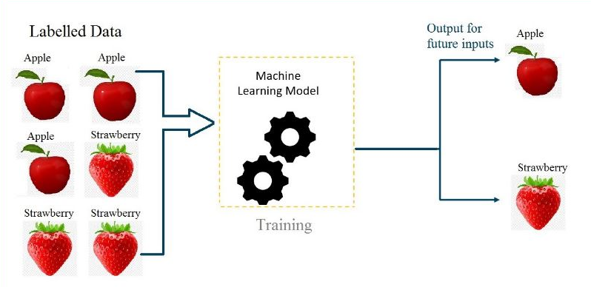
Supervised learning:
Supervised learning is a category of machine learning that uses labeled datasets to train algorithms to predict outcomes and recognize patterns.

Slide 17
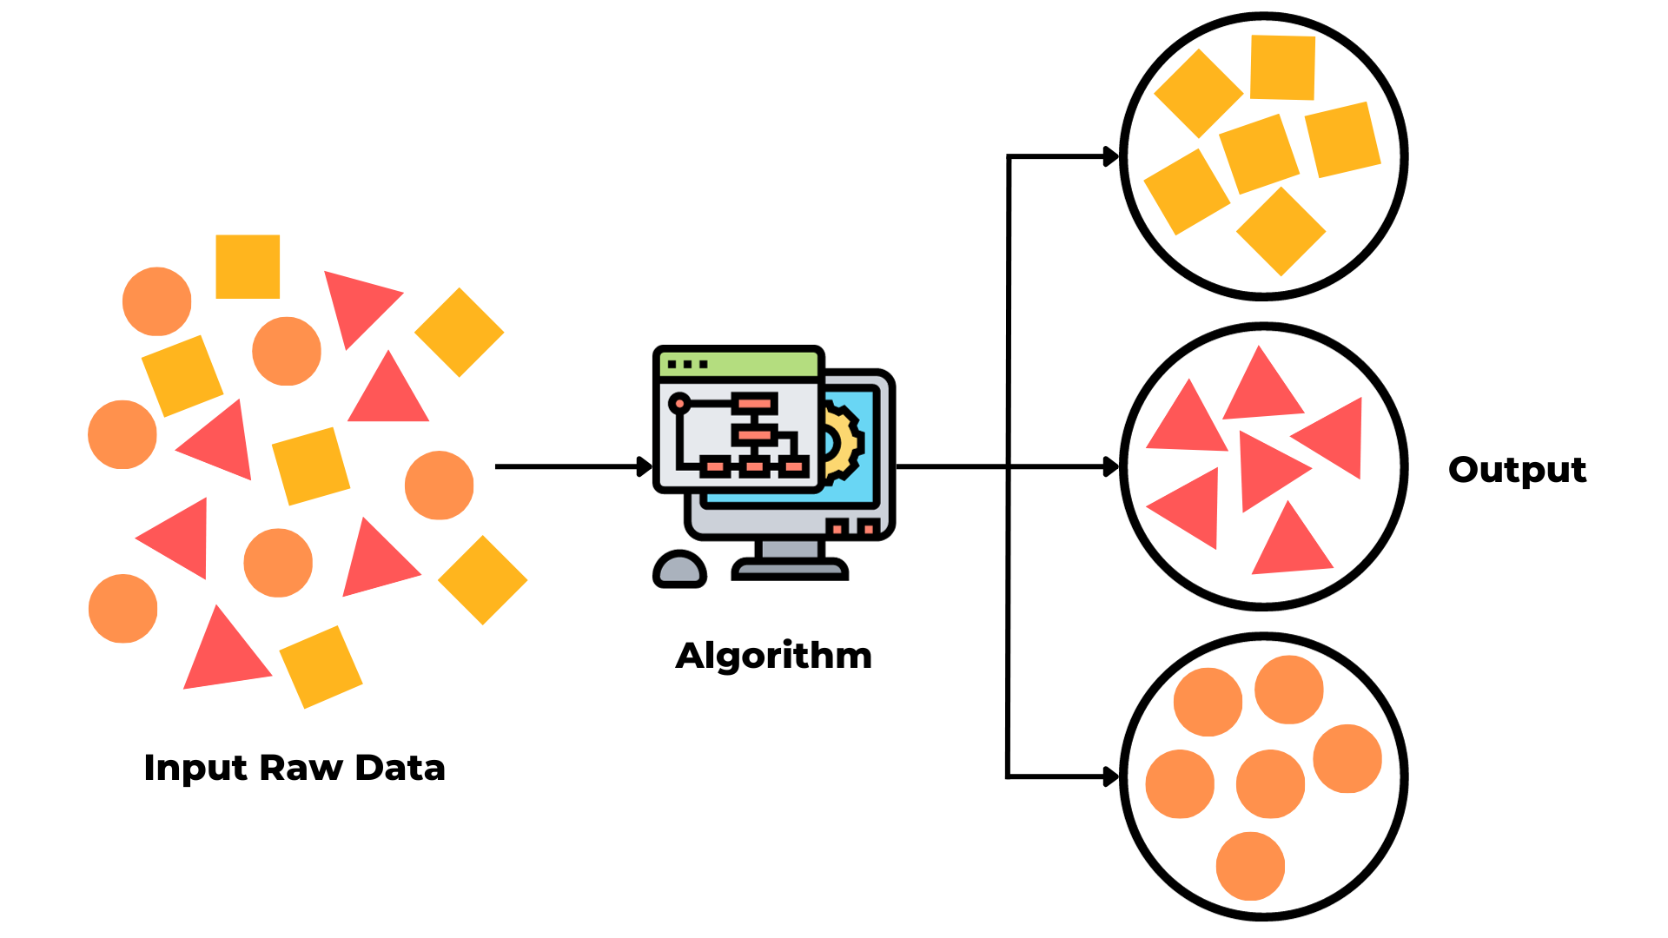
Unsupervised learning:
Unsupervised learning is a type of machine learning algorithm where the model learns from unlabeled data, meaning there are no predefined target labels.

Slide 18
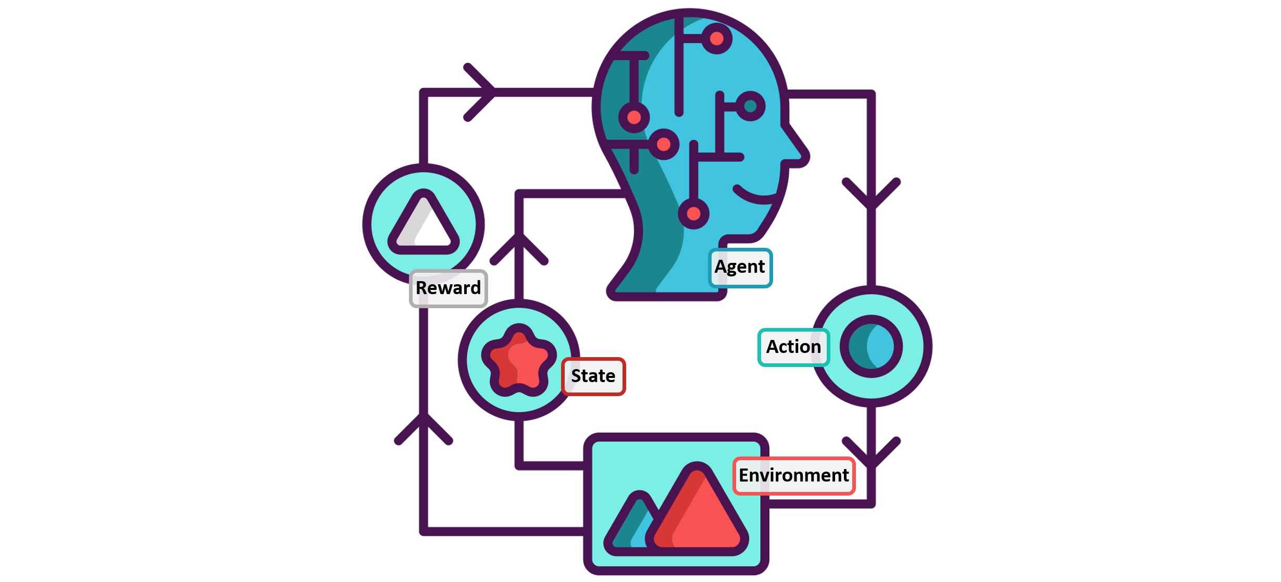
Reinforcement learning:
Reinforcement learning is a type of machine learning algorithm where an agent learns to make decisions by interacting with an environment. The agent receives feedback in the form of rewards or penalties based on its actions, and its goal is to learn the optimal strategy to maximize cumulative rewards over time.

Slide 19
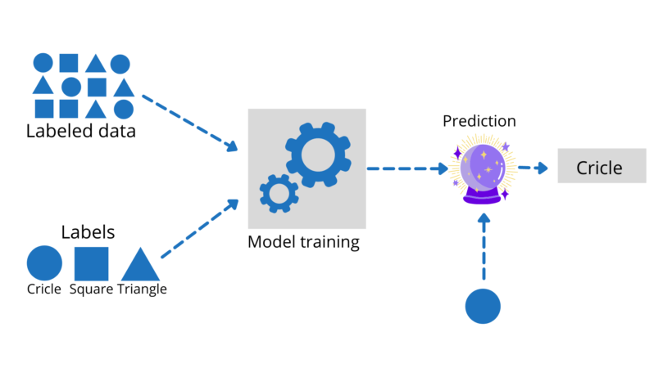
Supervised learning

Slide 20
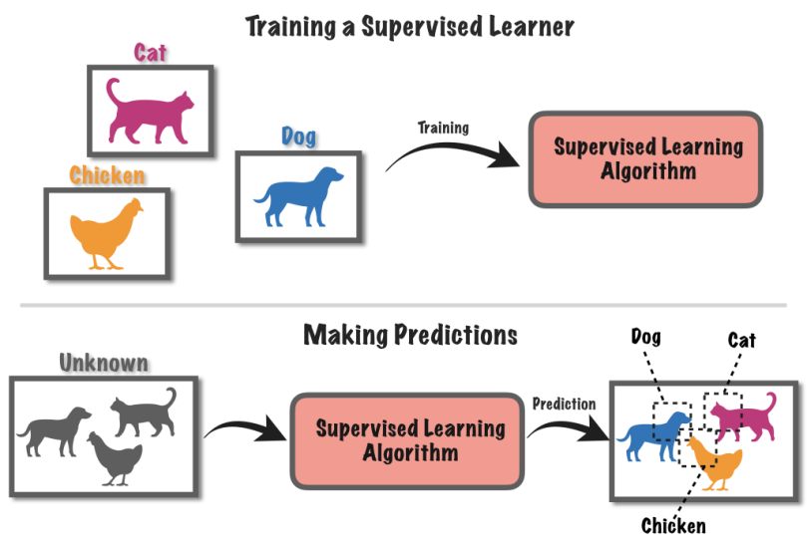

Slide 21
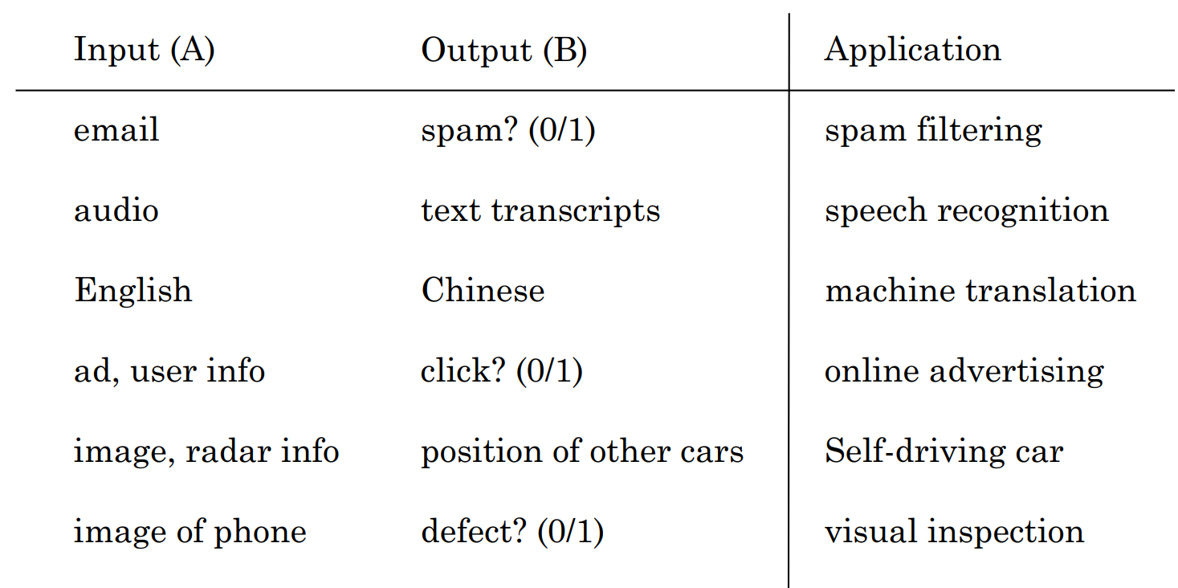
Supervised Learning Applications

Slide 22
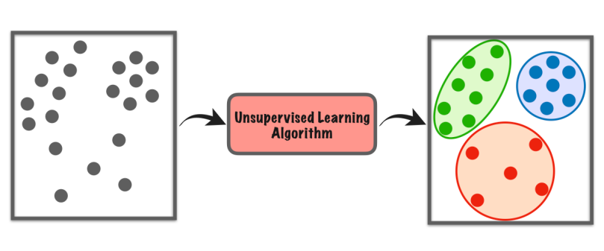
Unsupervised learning
Clustering
Dimensionality Reduction
Anomaly Detection

Slide 23
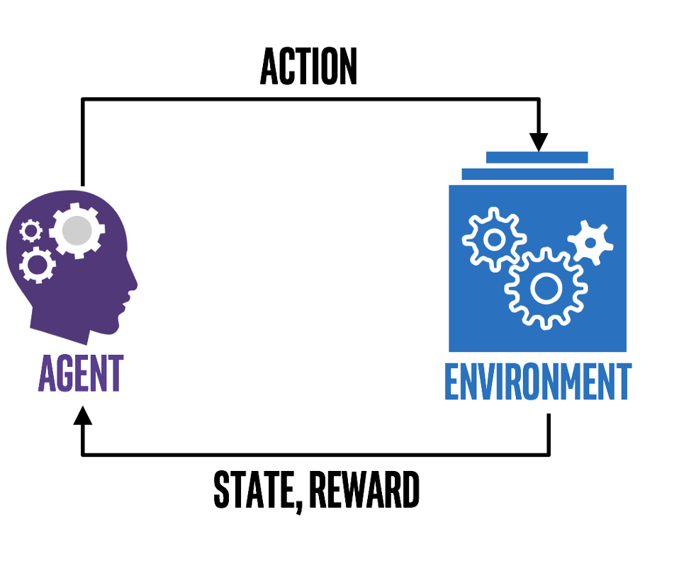
Reinforcement Learning

Slide 24
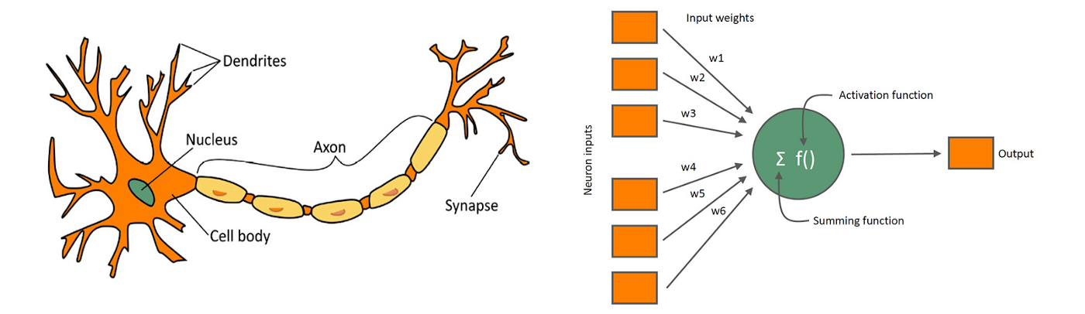
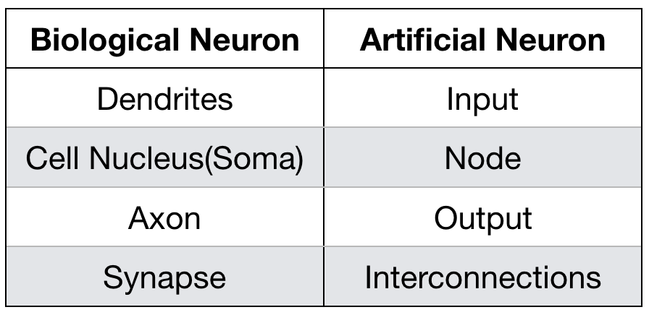
Biological Neuron
Artificial Neuron

Slide 25
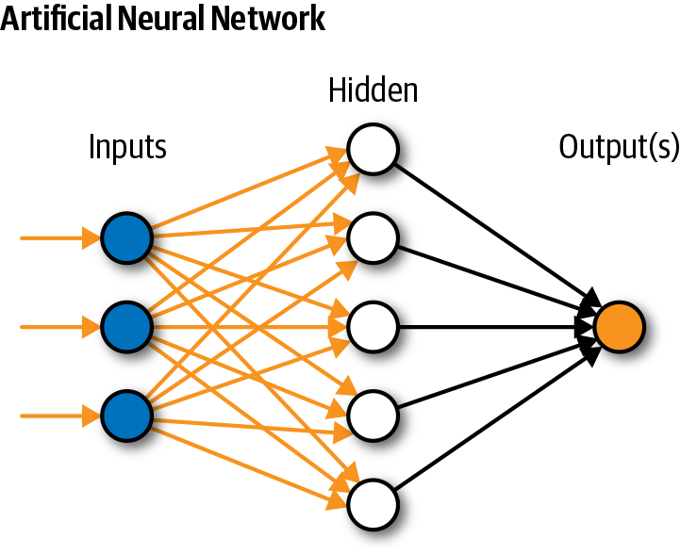
Neural Network

Slide 26
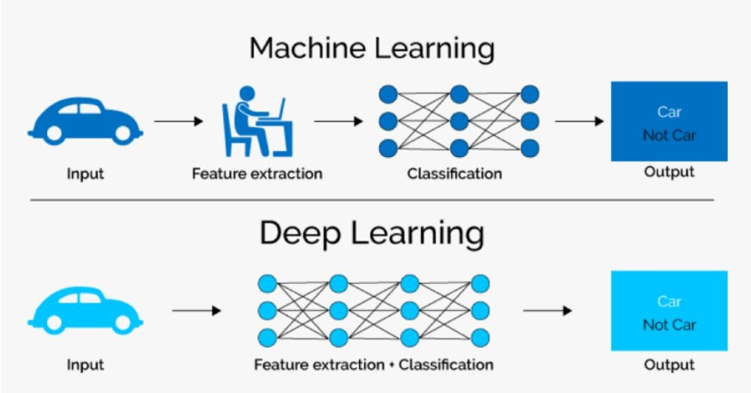
ML vs. DL

Slide 27
Generative AI
Text Generation
ChatGPT 3.5/4
Bard
Image generation
Dall-E3
Stable Diffusion
Music Generation
Music-LM
Video Generation
Runway ML Gen-2

Slide 28
Summary
What is AI?
ANI & AGI
Machine Learning vs Deep Learning
Generative AI

Slide 29
Next Lecture:
Lecture 02 - Machine Learning Essentials
Click Here

